Slide 1
IRI DATA LIBRARY

Slide 2
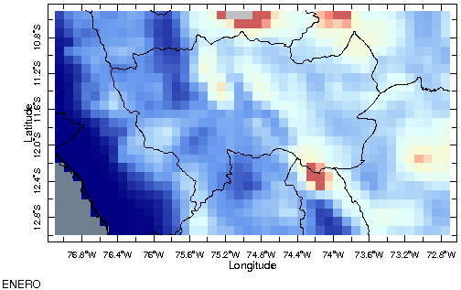
MAPAS CLIMATICOS DE LLUVIA MENSUAL (MEDIANA)

Slide 3
NOMBRES DE COLORES :https://iridl.ldeo.columbia.edu/dochelp/Tutorial/MVD/Visualization/colorchart.html
EJERCICIO-PRACTICA: http://iridl.ldeo.columbia.edu/SOURCES/.SENAMHI/.HSR/.PISCO/.Prec/.v2p1/.unstable/.monthly/.Prec/X/-77.1/-72.7/RANGEEDGES/Y/-12.95/-10.55/RANGEEDGES/T/(Mar%201981)/(Oct%202020)/RANGEEDGES/T/12/STEP/%5BT%5D/0.9/medianover/startcolormap/0./800./RANGE/SlateGrey/grey/NavyBlue/0./VALUE/CornflowerBlue/100./VALUE/LightCyan/300/VALUE/LightGoldenrodYellow/500/VALUE/salmon/600/VALUE/IndianRed/IndianRed/800/bandmax/grey/endcolormap/#expert
GIF MAKER:
https://ezgif.com/maker

Slide 4
CORRELACION:
http://iridl.ldeo.columbia.edu/SOURCES/.NOAA/.NCDC/.ERSST/.version5/.sst/T/(Feb%201981)/(Oct%202020)/RANGEEDGES/T/12/STEP/X/191.0/255.0/RANGEEDGES/Y/-11/7/RANGEEDGES/%5BX/Y/%5Daverage/SOURCES/.SENAMHI/.HSR/.PISCO/.Prec/.v2p1/.unstable/.monthly/.Prec/T/(Feb%201981)/(Oct%202020)/RANGEEDGES/T/12/STEP/%5BT%5D/correlate/#expert
https://iridl.ldeo.columbia.edu/SOURCES/.NOAA/.NCDC/.ERSST/.version5/.sst/T/(Feb%201981)/(Oct%202020)/RANGEEDGES/T/12/STEP/X/191.0/255.0/RANGEEDGES/Y/-11/7/RANGEEDGES/%5BX/Y/%5Daverage/SOURCES/.UCSB/.CHIRPS/.v2p0/.monthly/.global/.precipitation/X/-82.0/-68.0/RANGEEDGES/Y/-18.75/0/RANGEEDGES/T/(Feb%201981)/(Oct%202020)/RANGEEDGES/T/12/STEP/%5BT%5D/correlate/?Set-Language=es#expert
https://iridl.ldeo.columbia.edu/SOURCES/.NOAA/.NCDC/.ERSST/.version5/.sst/T/(Feb%201981)/(Oct%202020)/RANGEEDGES/T/12/STEP/X/191.0/255.0/RANGEEDGES/Y/-11/7/RANGEEDGES/%5BX/Y/%5Daverage/SOURCES/.UEA/.CRU/.TS4p01/.monthly/.pre/X/-82.0/-68.0/RANGEEDGES/Y/-18.75/0/RANGEEDGES/T/(Feb%201981)/(Oct%202020)/RANGEEDGES/T/12/STEP/%5BT%5D/correlate/?Set-Language=es#expert

Slide 5
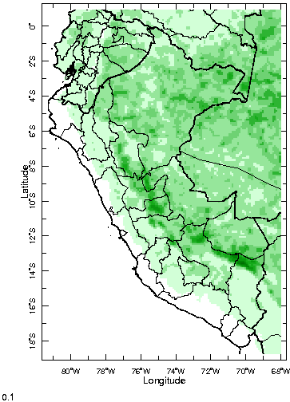
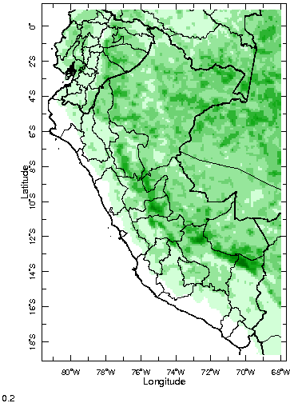
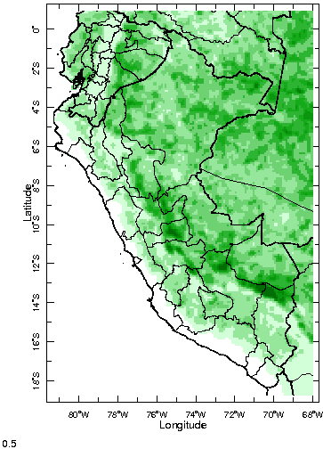
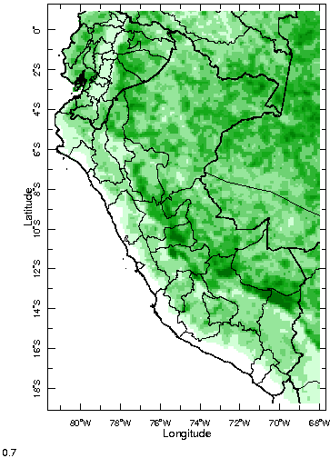
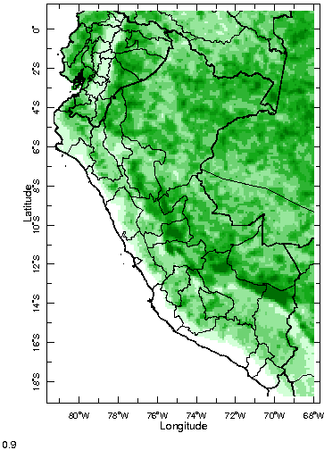
CALCULO DE PERNCENTIL
http://iridl.ldeo.columbia.edu/SOURCES/.SENAMHI/.HSR/.PISCO/.Prec/.v2p1/.unstable/.monthly/.Prec/T/(Feb%201981)/(Dec%202010)/RANGEEDGES/T/12/STEP/%5BT%5D/0.1/0.2/0.5/0.7/0.9/0.9/replacebypercentile/#expert
P10
P20
P50
P70
P90

Slide 6
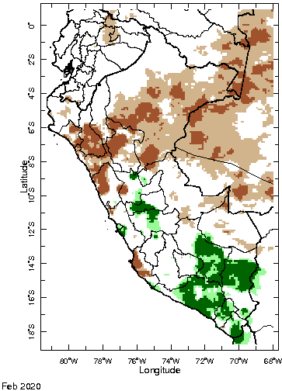
MONITOREO BASADO EN PERCENTIL-CATEGORIAS
https://iridl.ldeo.columbia.edu/expert/SOURCES/.SENAMHI/.HSR/.PISCO/.Prec/.v2p1/.unstable/.monthly/.Prec/T/(Feb%201981)/(Oct%202020)/RANGEEDGES/T/12/STEP/%5BT%5Dpercentileover/startcolormap/DATA/0/1/RANGE/white/sienna/sienna/0/VALUE/sienna/0.1/bandmax/tan/RGBdup/0.2/bandmax/white/white/0.8/bandmax/PaleGreen/RGBdup/0.9/bandmax/DarkGreen/RGBdup/1.0/bandmax/RGBdup/endcolormap/#expert

Slide 7
MONITOREO BASADO EN PERCENTIL
http://iridl.ldeo.columbia.edu/ds%3A/SOURCES/.SENAMHI/.HSR/.PISCO/.Prec/.v2p1/.unstable/.monthly/.Prec/dup/T/(Jan%201981)/(Dec%202010)/RANGE/T/12/splitstreamgrid/%5BT2%5D0.0/0.1/0.2/0.3/0.4/0.5/0.6/0.7/0.8/0.9/1.0/1.0/replacebypercentile/%5Bpercentile%5Dboundedtablefunction/startcolormap/DATA/0/1/RANGE/white/sienna/sienna/0/VALUE/sienna/0.1/bandmax/tan/RGBdup/0.2/bandmax/white/white/0.8/bandmax/PaleGreen/RGBdup/0.9/bandmax/DarkGreen/RGBdup/1.0/bandmax/RGBdup/endcolormap//name//prcp_percentiles/def//long_name/(PERCENTIL%20EXTREMO%20PISCO.V2.1_PP%20%20%40FAP-DIRMA)/def/SOURCES/.SENAMHI/.HSR/.PISCO/.Prec/.v2p1/.unstable/.monthly/.Prec/T/(Jan%201981)/(Dec%202010)/RANGE/T/(days%20since%201960-01-01)/streamgridunitconvert/T/differential_mul/T/(months%20since%201960-01-01)/streamgridunitconvert//units/(mm/month)/def/yearly-climatology/10/flaglt/%5BT%5DregridAverage//name//dry_mask/def/%3Ads/.prcp_percentiles/#expert

